Slide 1
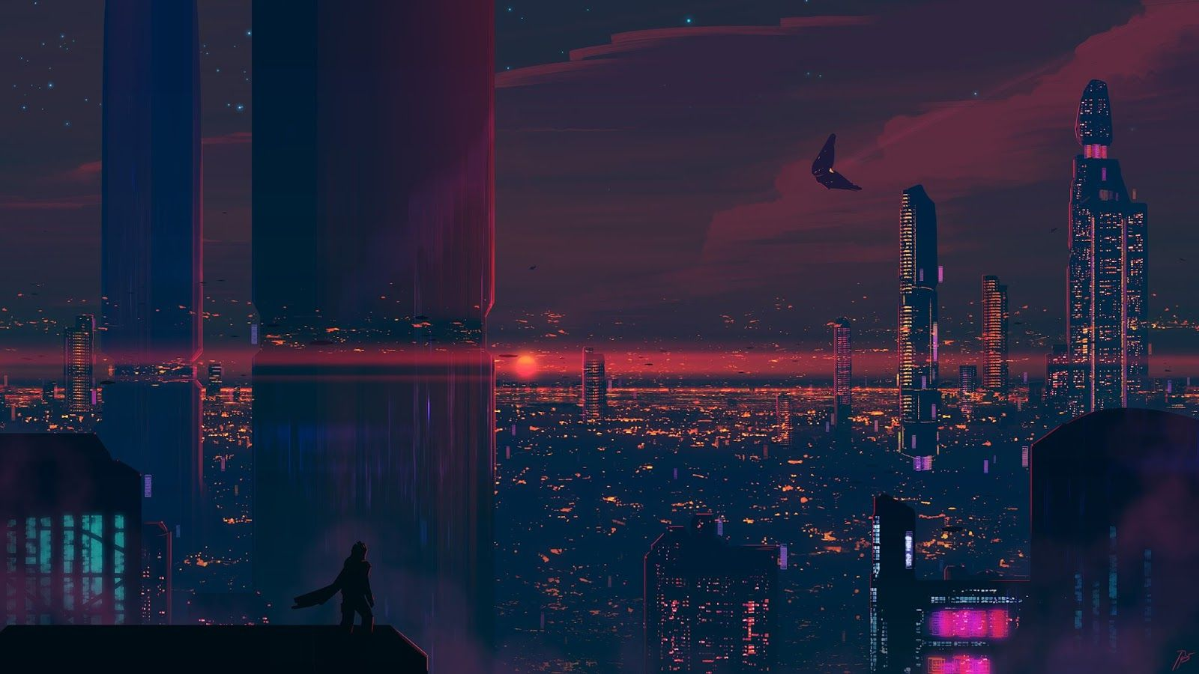

IstanHack Hackathon
GearTech Case: Improve Syndote game with Web3 Dynamics
Ist Blockchain Week 14.11.2022-16.11.2022

Slide 2
The Task
Name | Description | Points
Syndote game | Play, Learn & Earn! Create & deploy a unique game strategy. Customize an algorithm template and compete with other developers! | 2 - 6
Build custom gameplay mechanics for a “Free stop” & Opportunity cells (see screenshot above) (Difficulty: Easy) | Ideas for inspiration: - Game of chance [https://wiki.gear-tech.io/docs/examples/lottery]; - Jackpot; - Teleportation; - Balance slashing/airdrops; - Your cool idea. | 4 - 8
Extension for Syndote (Difficulty: Medium) | Ideas for inspiration: - Automated gNFT in-game public auction - re-use existing Dutch-auction implementation [https://wiki.gear-tech.io/docs/examples/dutch-auction]; - Betting layer for viewers and participants; - Your cool idea. | 6 - 12
Extension for Syndote (Difficulty: Hard) | Ideas for inspiration: - gNFT Syndote lending solution; - SDNT lending (Bank-to-Algorithm / Algorithm-to-Algorithm); - Algorithm-to-Algorithm trade offers within an on-chain game session (trade spread limit 50%). - Your cool idea. | 8 - 16

Slide 3
Our Workflow
We understood the Syndote and the Player program flows by drawing execution graphs.
We found the programs main loops or main flows.
We added basic logics to player and Syndote programs.
We defined our gameplay actions for Syndote and implemented them first.
We implemented different gaming algorithms for players.

Slide 4
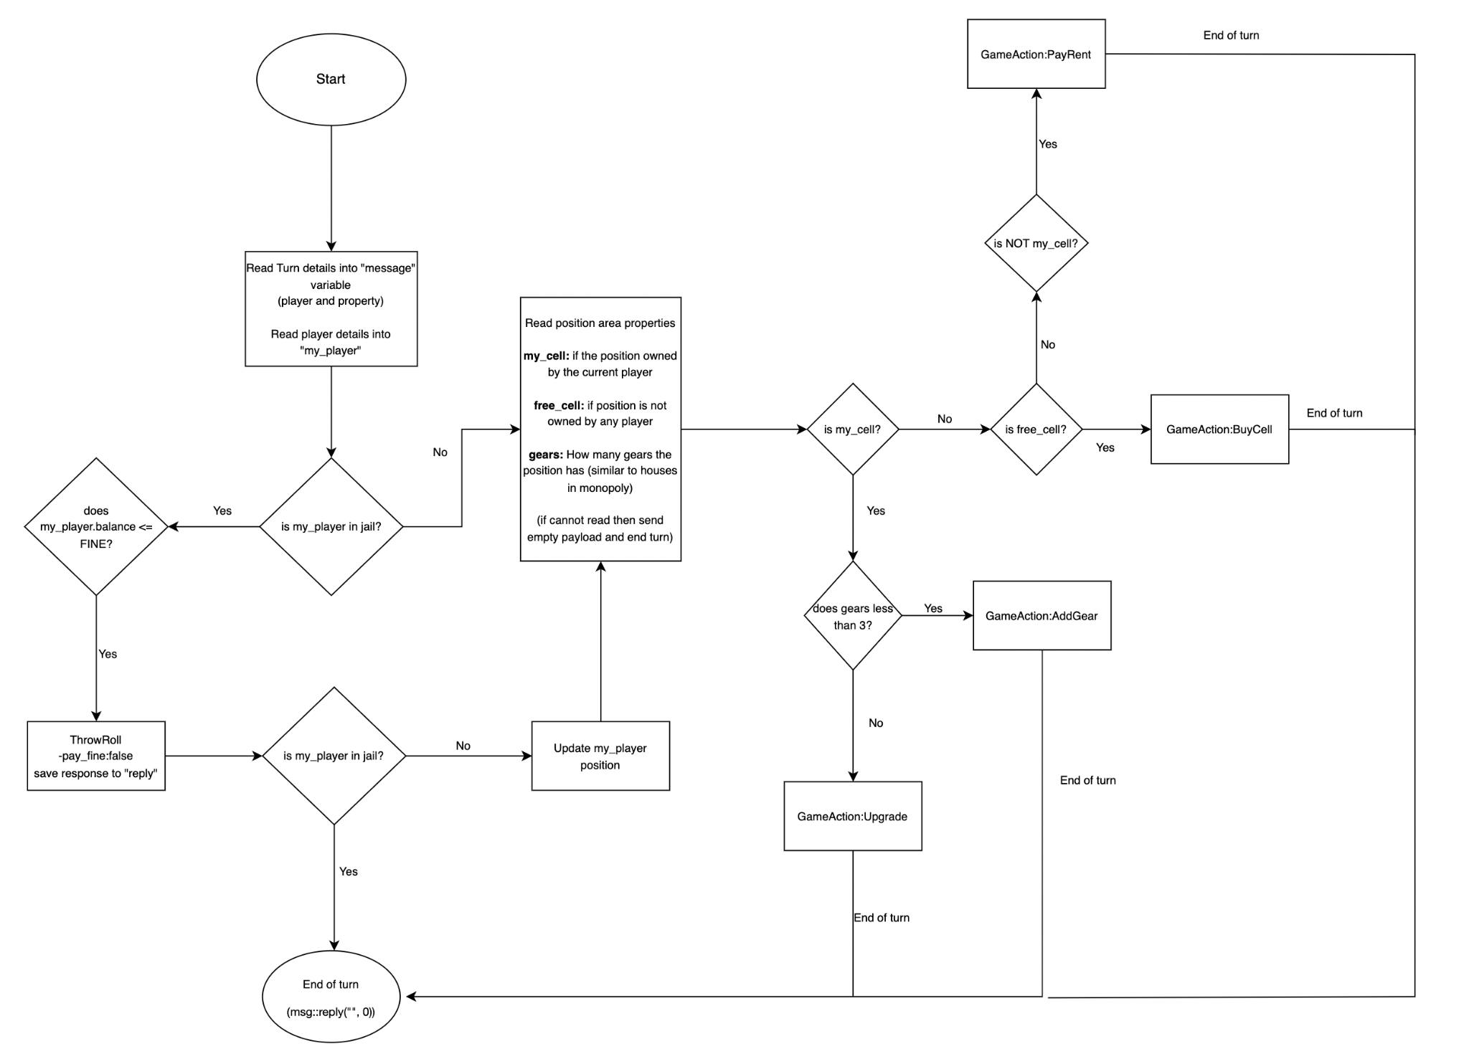
Player Program Flow

Slide 5
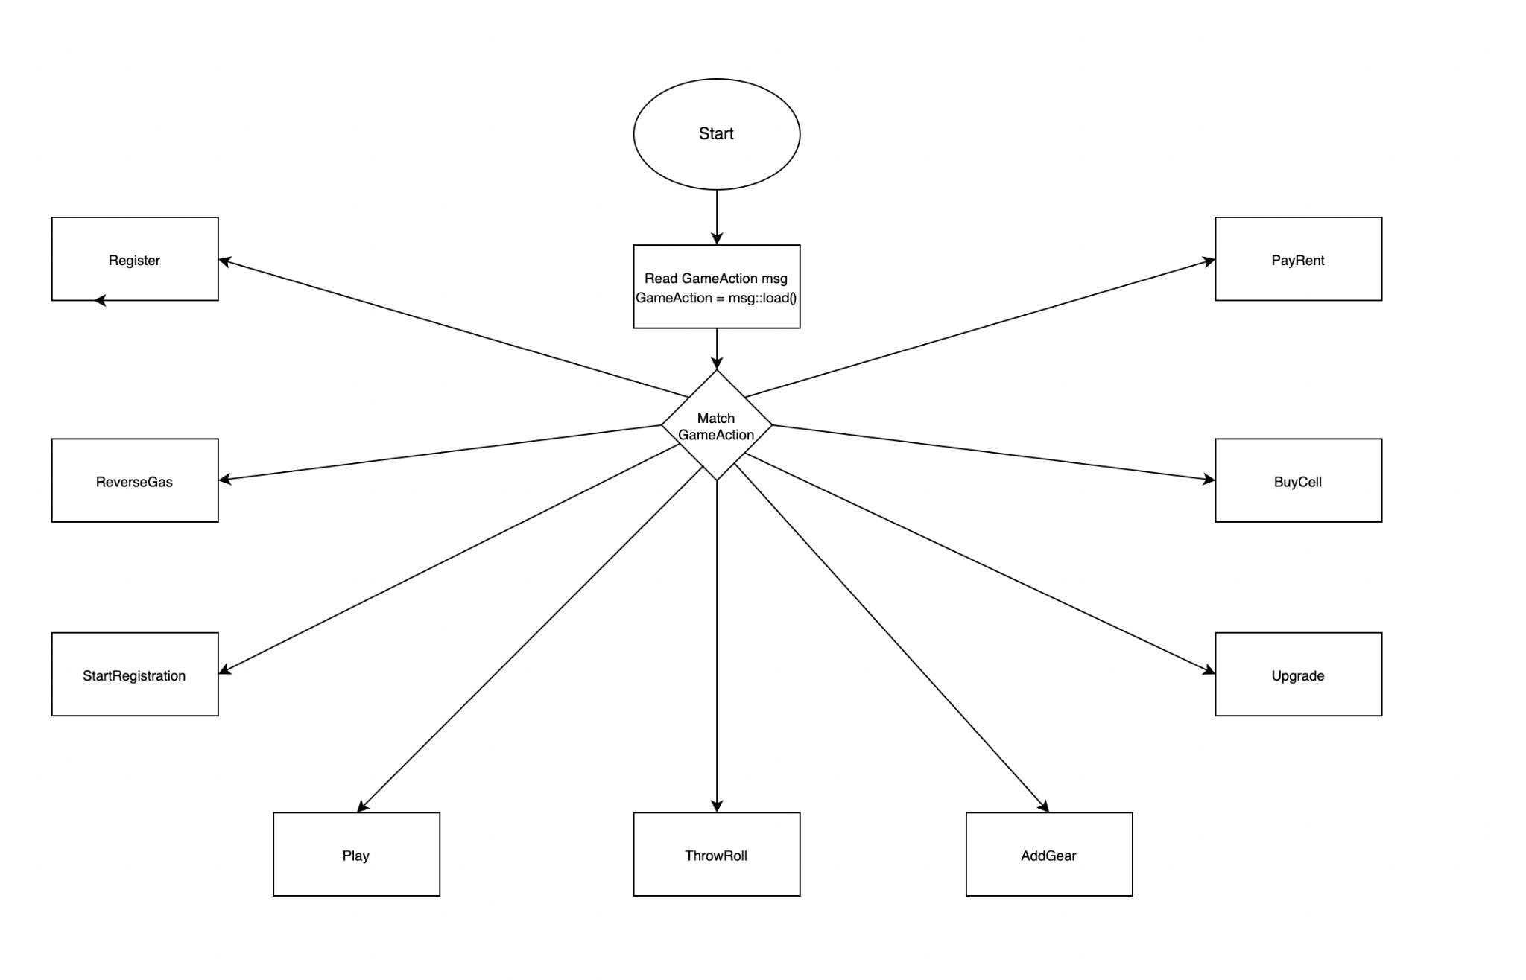
Syndote Program Flow

Slide 6
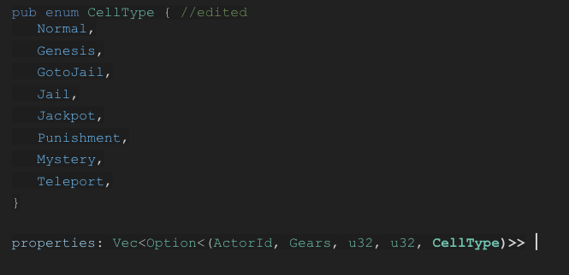
Editing the Game
Added 3 more player contracts by copying the main player program. Edited Rust test cases and Cargo.toml.
Modified the play() function.
Implemented detailed debug logging.
Added functionality: Player sells its property if it cannot pay the rent.
Implemented Enum CellTypes and added CellType for each cell.
Implemented special cell areas.
Genesis => Start cell, players earn tokens in each visit.
GoToJail => Teleports player to jail cell.
Jail => Jail cell.
Jackpot => Players earn tokens when they visit.
Punishment => Players lose tokens when they visit.
Mystery => Players rolls dices and can either lose or earn tokens, or they can wait.
Teleport => Players can teleport to the next teleport cell by paying a fee, or they can wait.

Slide 7
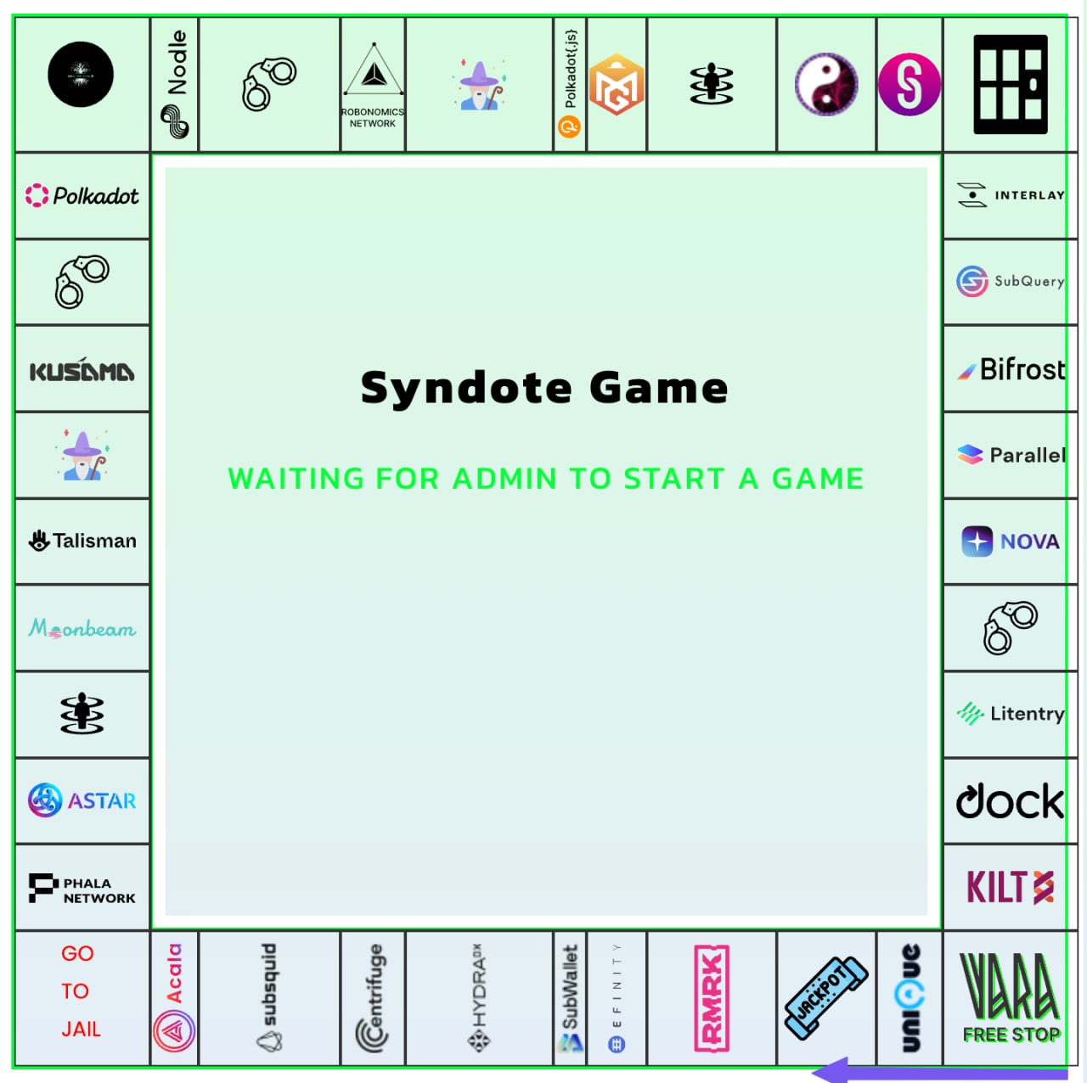
Editing The Front-End
We edited the front-end and implemented our custom cells;
0 => Genesis cell
2,16,38 => Punishment cells
4,36 => Mystery cells
7,33 => Teleport cells
20 => Jackpot!

Slide 8
Adding New Player Programs
We implemented 4 different player programs (smart contracts).
Default (we edited only minor things)
Does not accept all Mystery boxes.
Does not use teleport boxes.
Tries to buy a cell if its not owned.
Pays jail fine.
When visit owned cell tries to
Greedy
Does not accept all Mystery boxes.
Does not use teleport boxes.
Buys the cell if it is not owned, and price <=2500.
Does not pay jail fine.
Sells property to admin, if it cannot pay the rent (does not get penalty.)
When visit owned cell AddGearx3, Upgrade till they are Gold and stop, if there is enough balance.
Risk Taker
Accepts all Mystery boxes.
Use all teleport boxes.
Pays jail fine.
Buys the cell if it is free, and player has enough balance.
When visits owned cell AddGearx3, Upgrade till they are Gold and stop, if there is enough balance.
Psyche
Accepts all Mystery boxes.
Use all teleport boxes.
Pays jail fine.
%60 chance to buy the cell if it is not owned, and player has enough balance.
%70 chance to AddGearx3 when visits owned cell, Upgrade till they are Gold and stop.

Slide 9
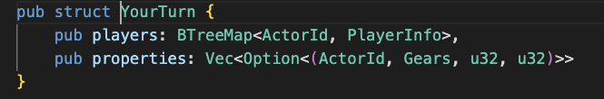
Encountered Problems
Miscalculated array length for properties
This was really basic but it took a lot of the development time.
Decode Errors
After editing the Game property, we encountered a decode error while trying to communicate with the player programs. Even if we arranged the player programs properties as same with Game we cannot solve this problem and a find workaround.

Slide 10
Future Development: Implementing GFT-20 and gNFT
1) Changing the game money with fungible tokens using https://wiki.gear-tech.io/docs/examples/gft-20
In order to register, every player will need to deposit token fee.
At the end of the game, main program cuts a fee and transfers all the deposits to the winner player.
Game tokenomics will open huge trading possibilities for the token.
2) Changing the properties with gNFT using https://wiki.gear-tech.io/docs/examples/gnft-721
When the game begins, main contract will open a NFT collection in the NFT marketplace contract.
Each property(cell) area will be deployed as NFT to the marketplace.
Players can sell, offer, auction property areas thought NFT marketplace during the game.
Customized cards could be implemented as NFT, such as “Jail Free Card” or “Teleportation”

Slide 11
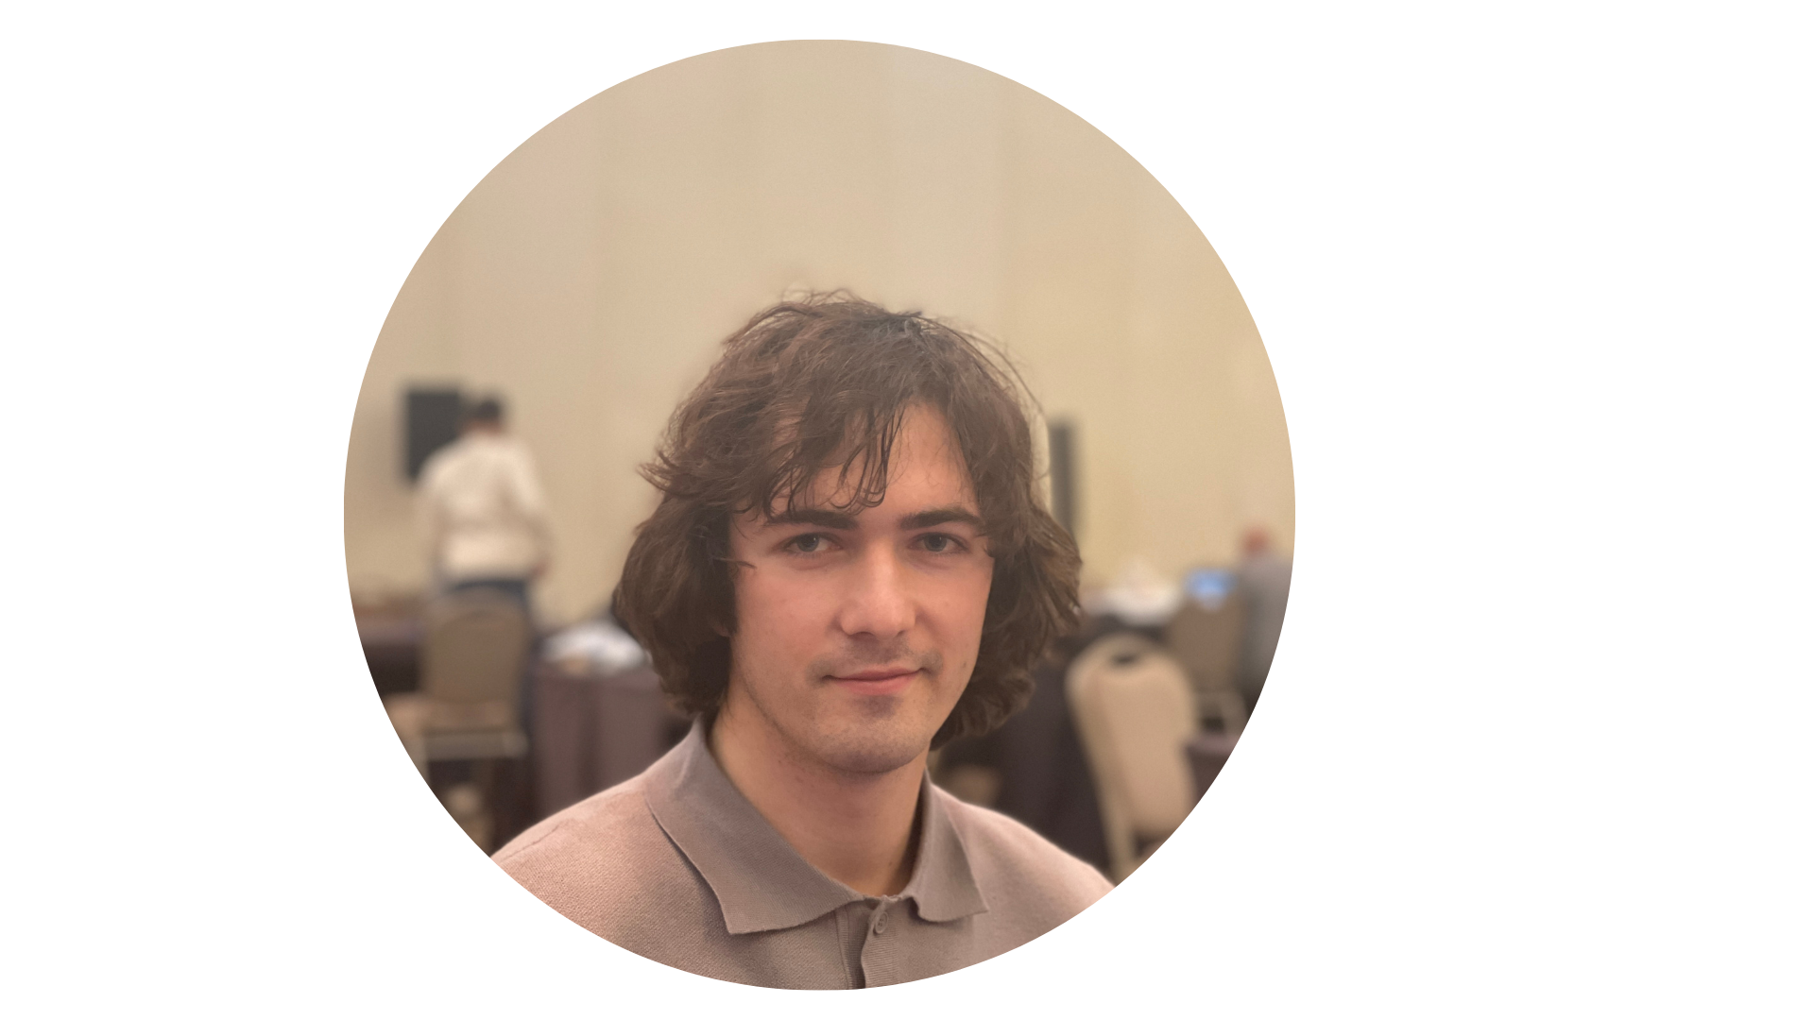
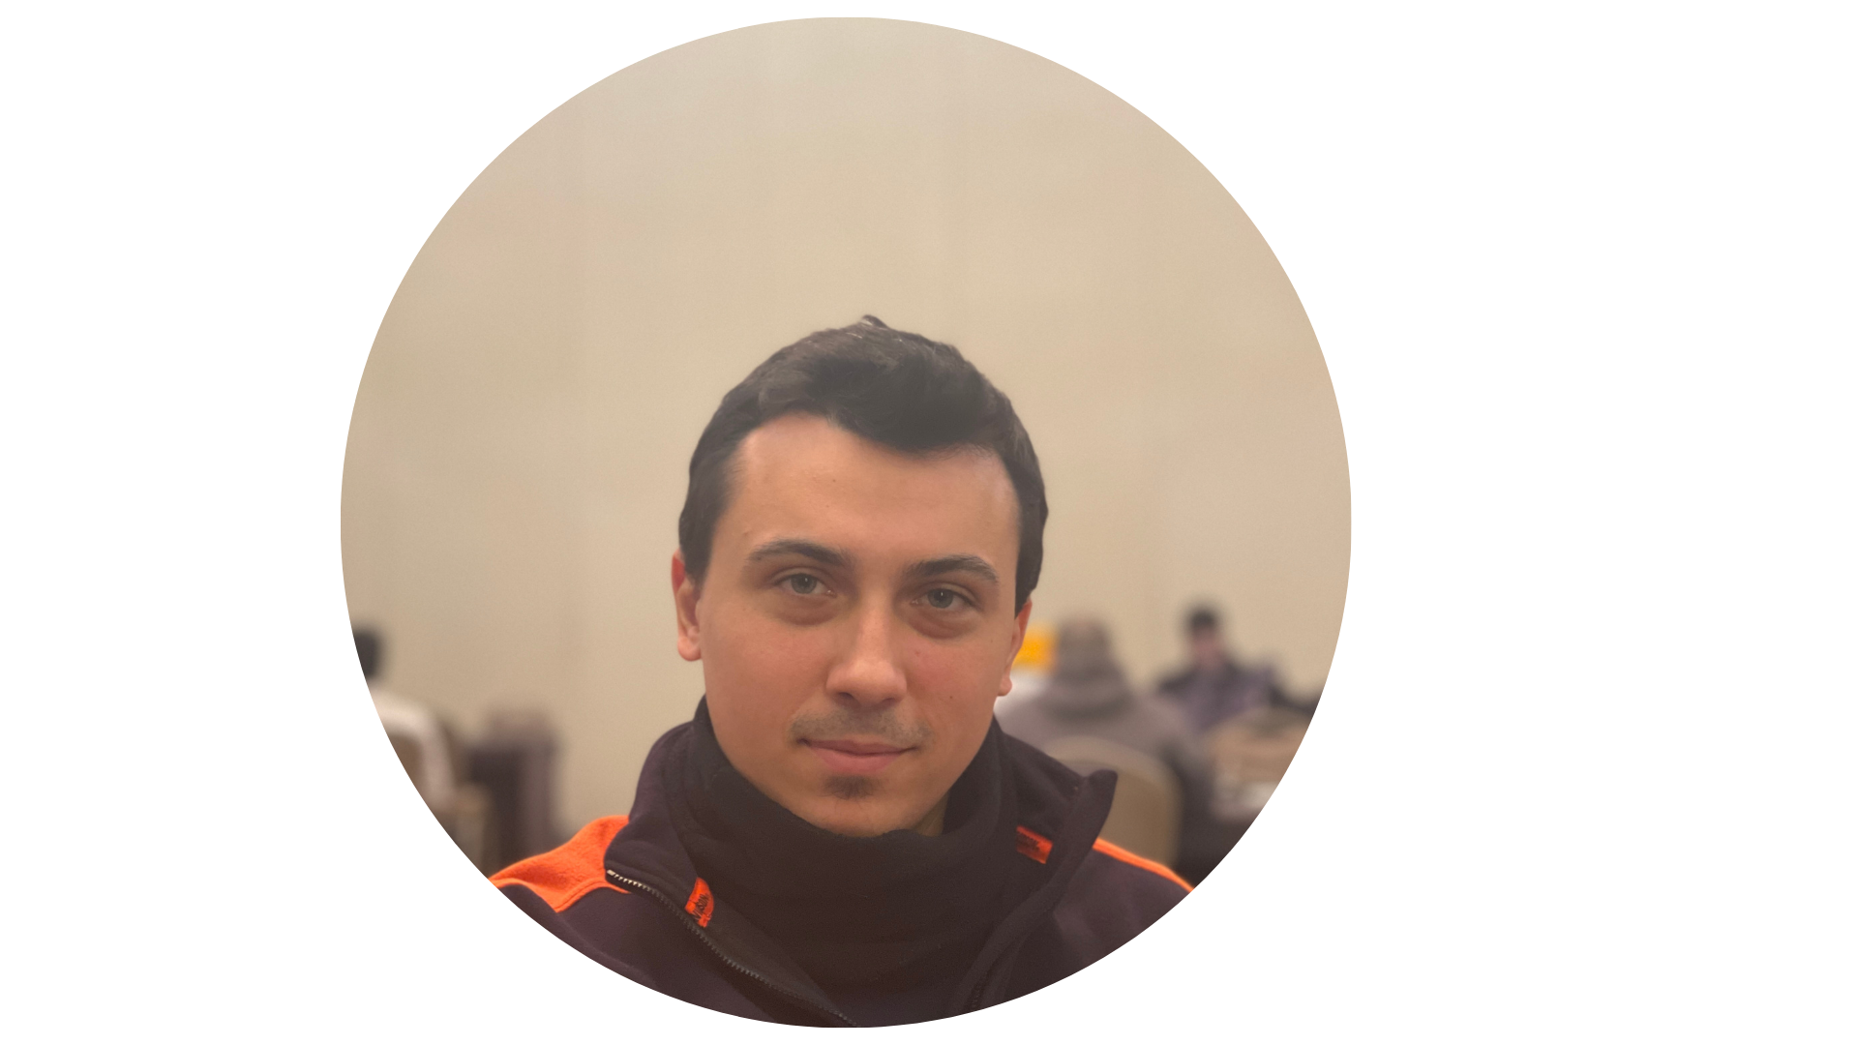
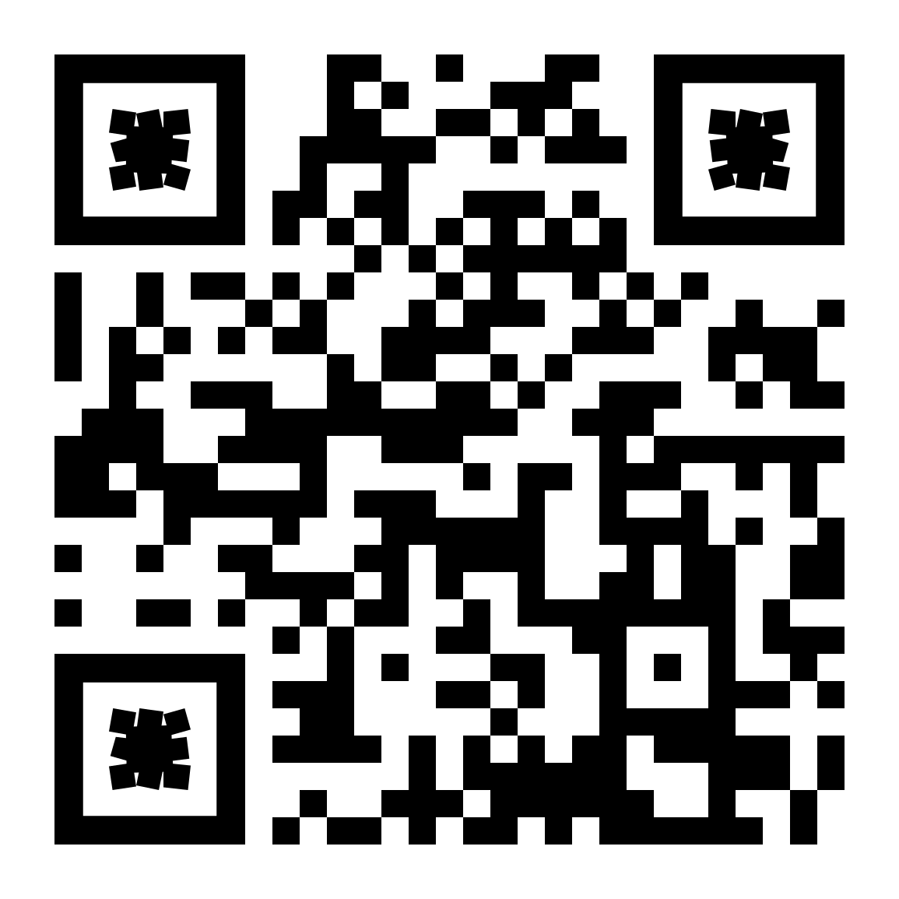
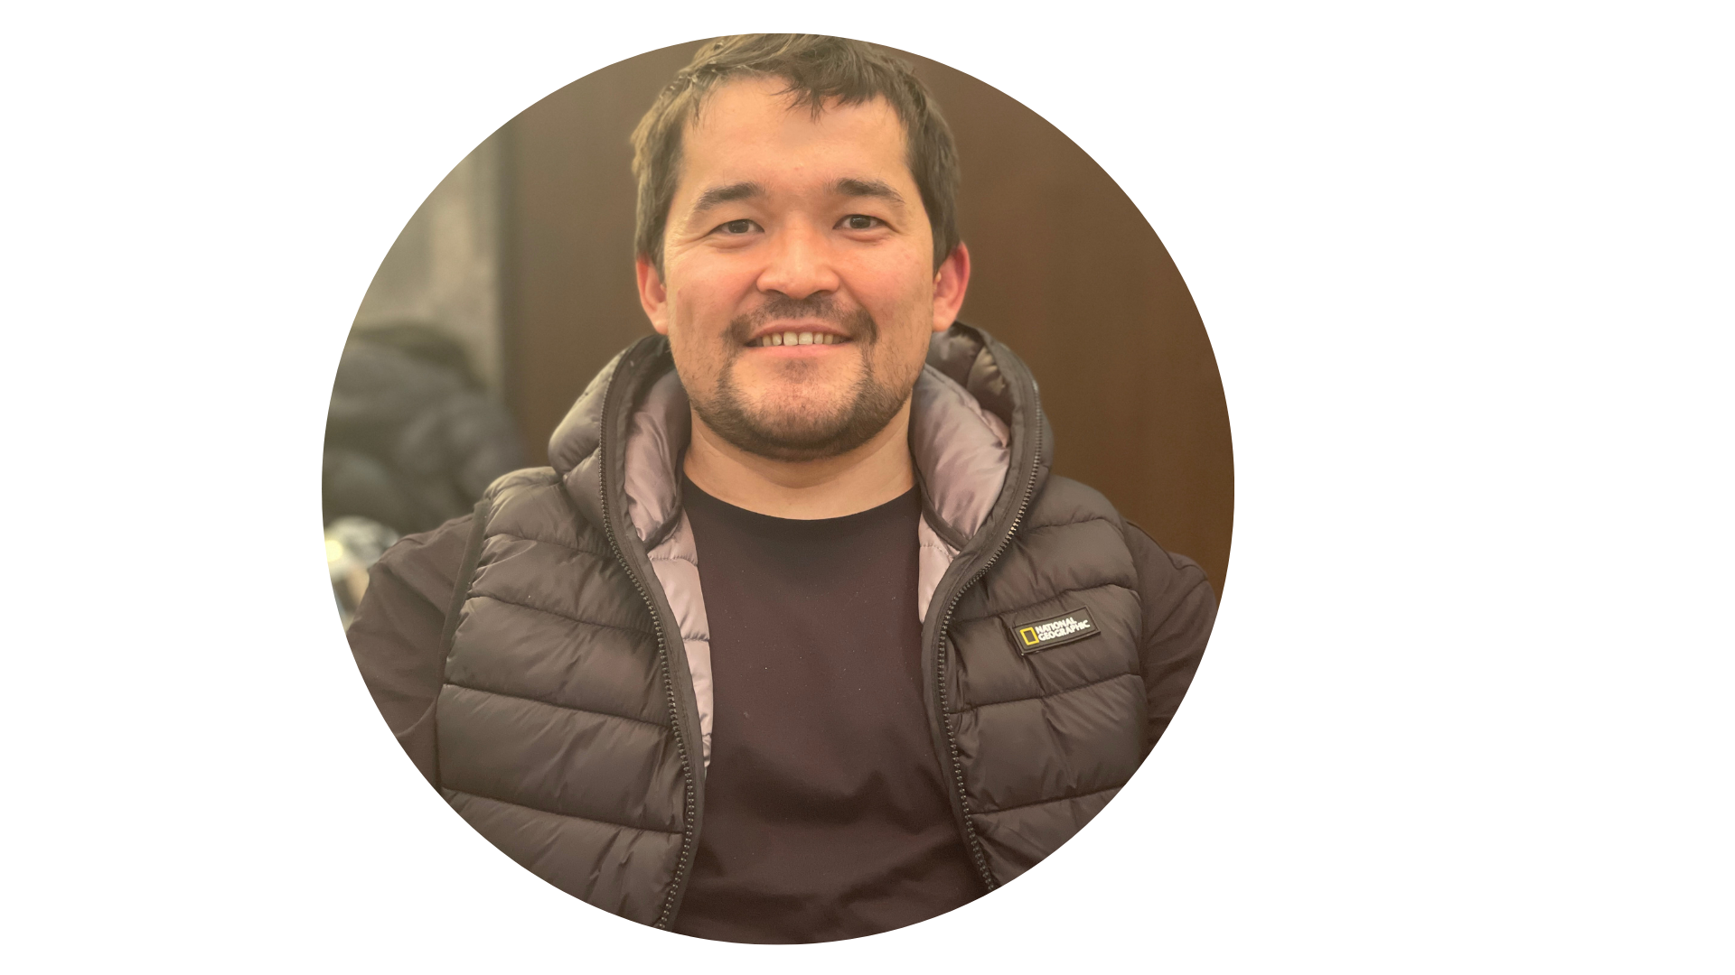
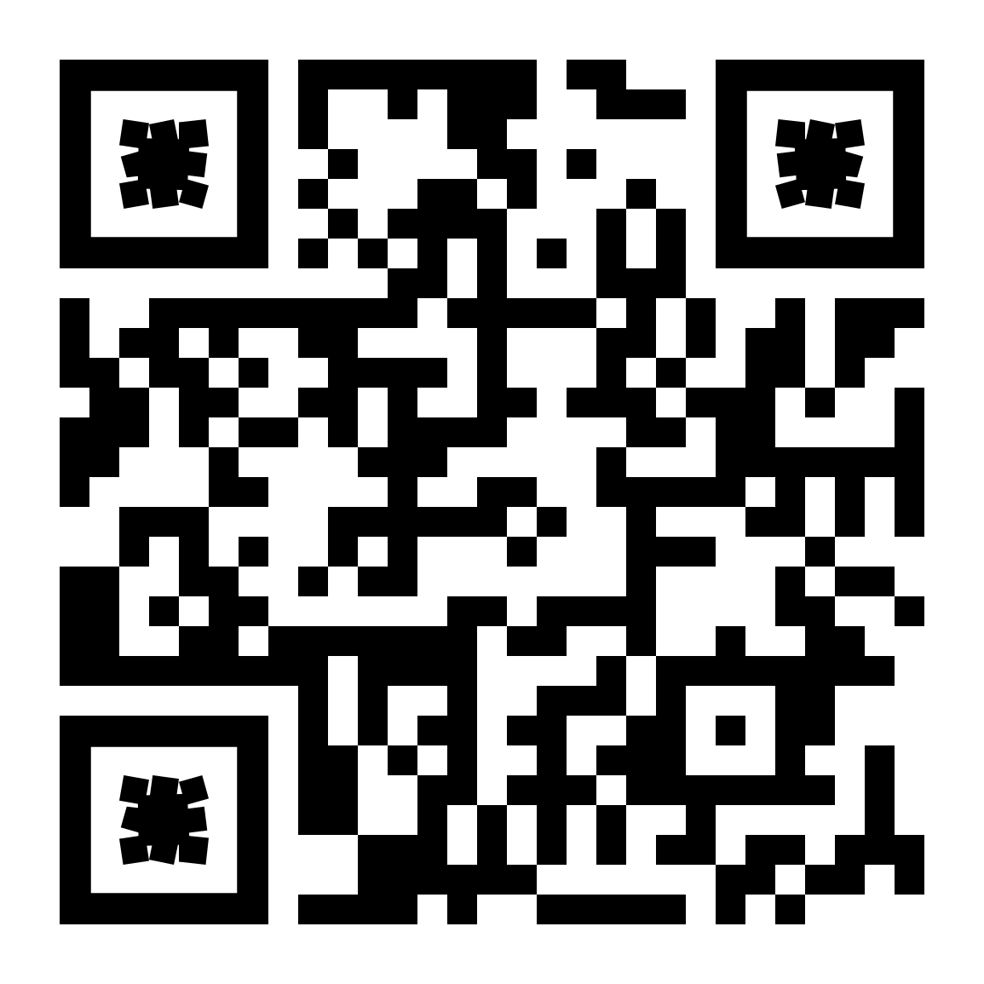
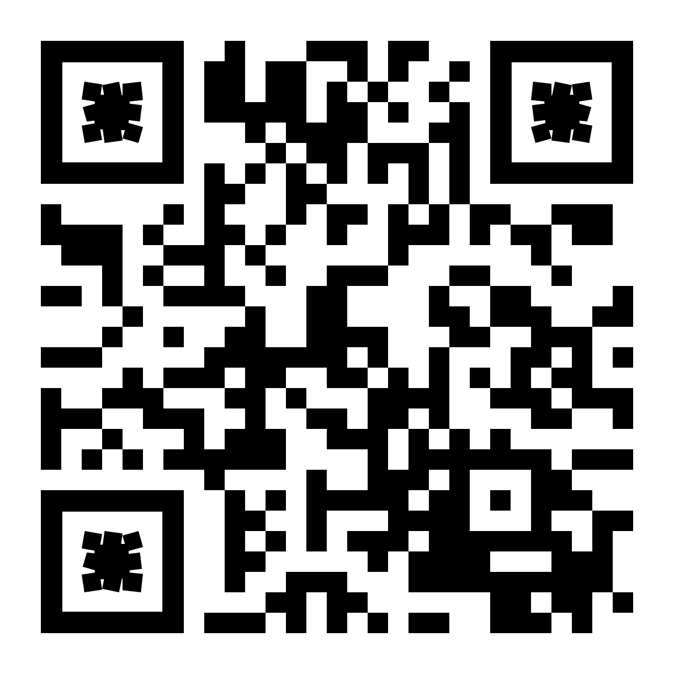
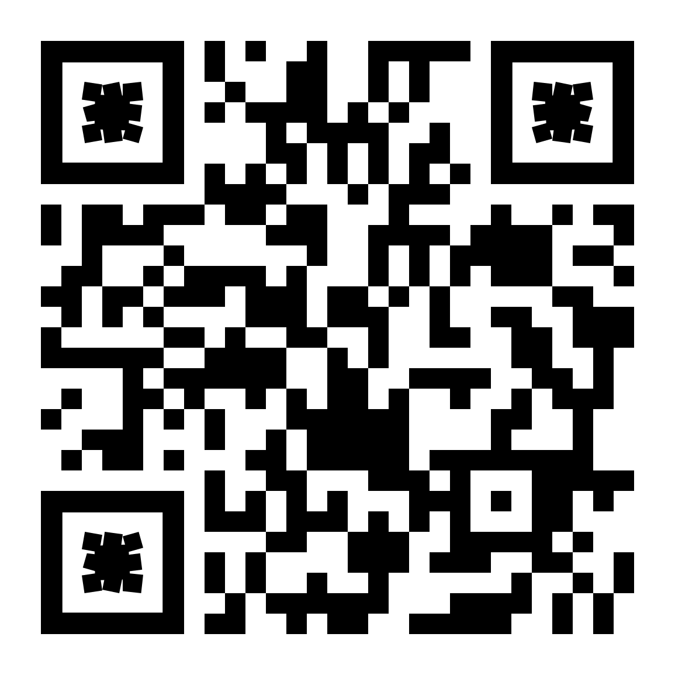
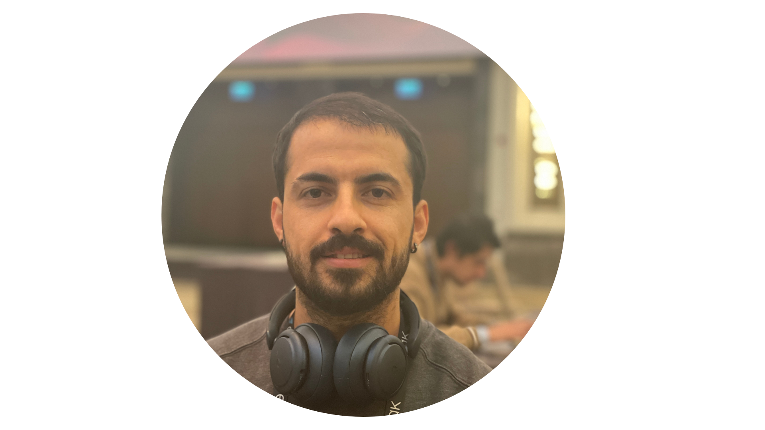
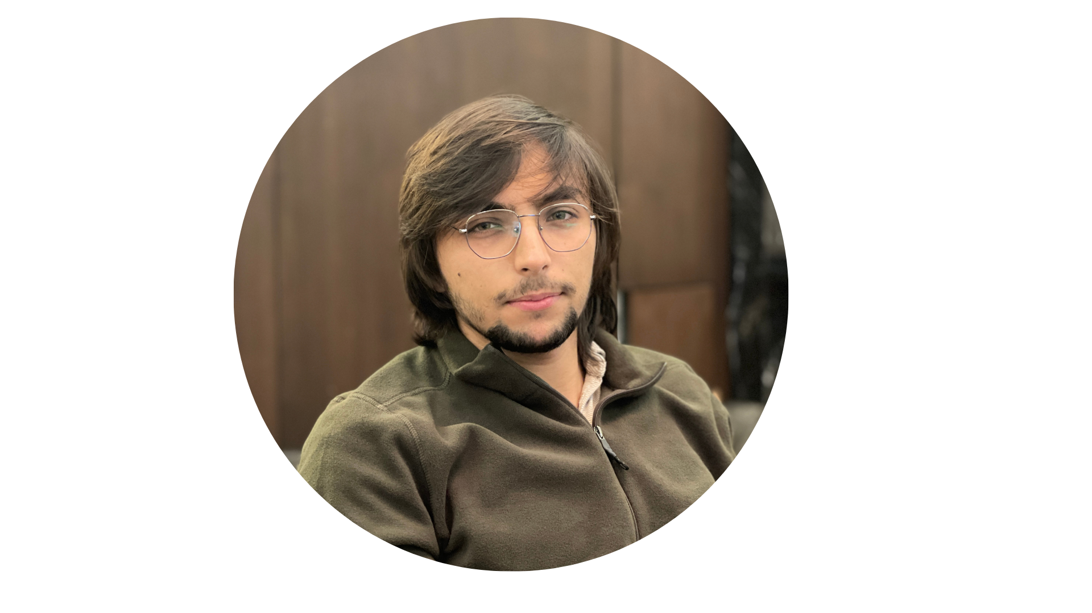
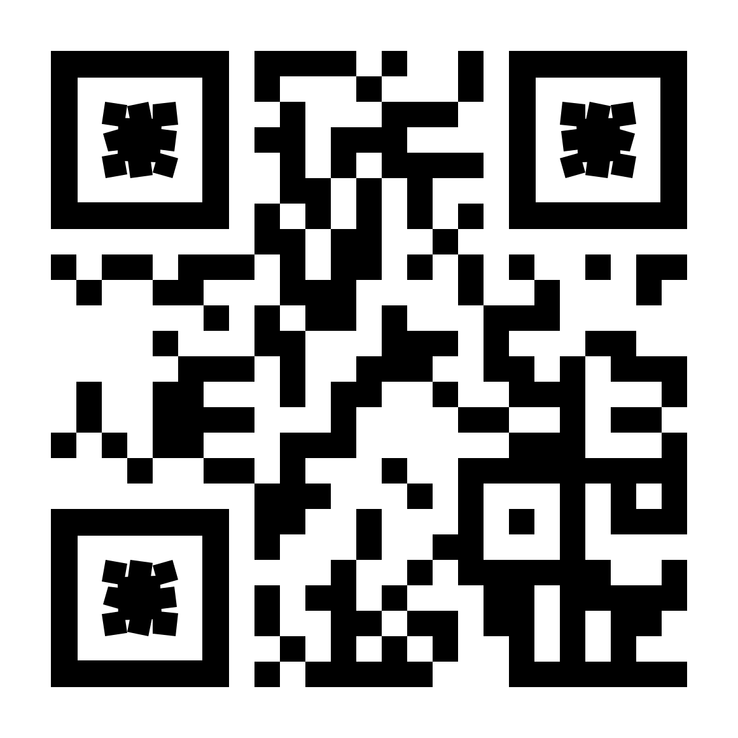
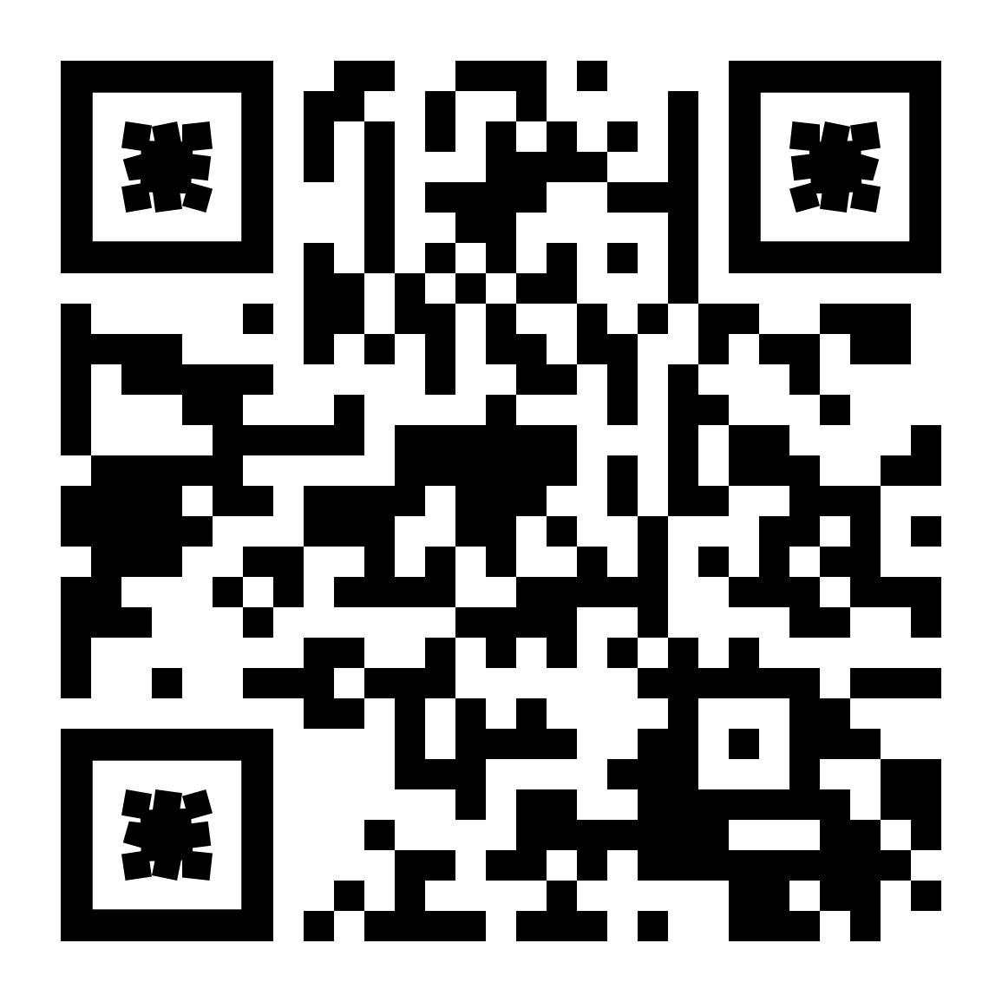
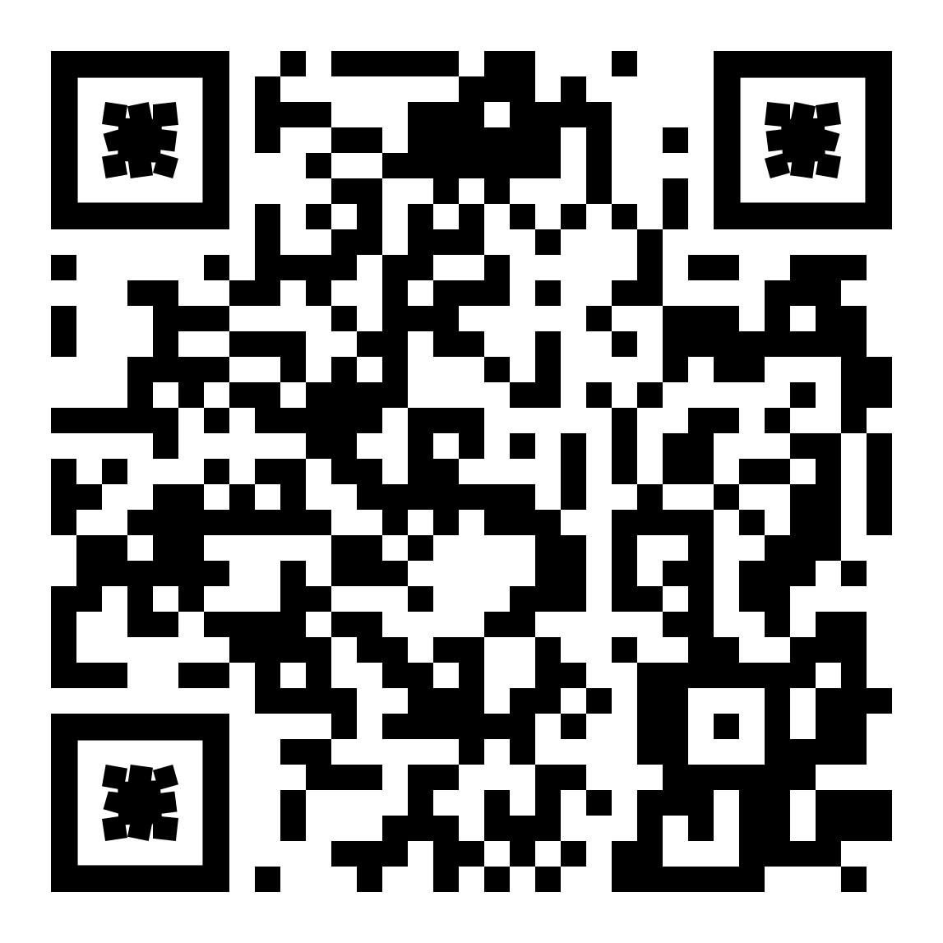
Thank you
Ilshat Karazbaev
Alexey Safonov
Nihat Alp Onaran
Giray Hakan
M.Metehan Topalhan
Project GitHub

